Slide 1
An Analysis of the Movie Industry
Data Science Project 2
Presented by:
Tran Hieu Le, Totyana Hill, Fahim Ishrak, Zhilin Wang

Slide 2
Contents
Introduction
Revenue Prediction
Profit Prediction
Profitability Prediction
Revenue Seasonal Trending
Conclusion

Slide 3
Introduction
The American film industry generated $43.4 billion in revenue last year, increasing in each of the past five years at an annualized rate of just 2.2%.
According to the IBISWorld report, even with stagnant box office revenue, the industry’s revenue will continue to increase.
Most films shown at the domestic box office make up less than a quarter of the revenue they generate.
If box office predictions are more accurate, then studios and investors would save millions and appropriately allocate the necessary funds.

Slide 4
Questions
Which factors will best determine a movie’s revenue performance and profitability?
How does seasonality impact revenue generated?
Goals
Construct and evaluate different kinds of models to predict a movie’s revenue and profitability.
Evaluate models and find the best predictive model.

Slide 5
Revenue Prediction

Slide 6
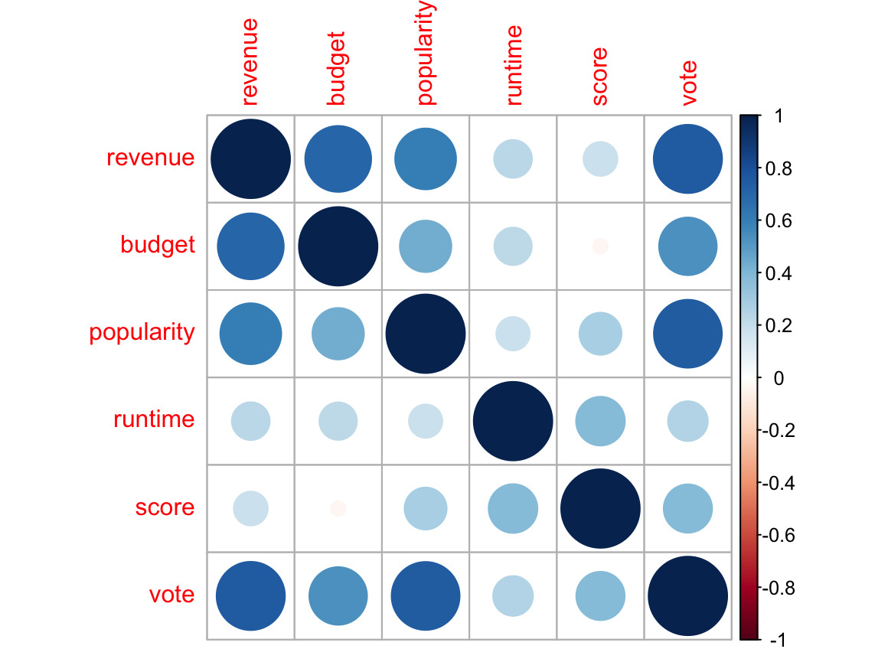
Correlation Matrix

Slide 7
Anova Test
Predictor | Company | Season | Genres
p-value | 1.13e-28 | 5.29e-10 | 2.58e-80
All the p-values are smaller than 0.05 level.
The overall effect of company, season and genre on revenue are statistically significant.

Slide 8
Data Summary
 | revenue | budget | vote | score | popularity | runtime
Min. | 5.00e+00 | 1.0e+00 | 1 | 2.30 | 0 | 41
1st Qu. | 1.71e+07 | 1.05e+07 | 179 | 5.80 | 10 | 96
Median | 5.52e+07 | 2.50e+07 | 471 | 6.30 | 20 | 107
Mean | 1.21e+08 | 4.07e+07 | 978 | 6.31 | 29 | 111
3rd Qu. | 1.46e+08 | 5.50e+07 | 1148 | 6.90 | 37 | 121
Max | 2.79e+09 | 3.80e_08 | 13,752 | 8.50 | 876 | 338

Slide 9
Linear Regression
Formula: revenue ~. , data = training data
R-squared | Adj R-squared | F-statistic | p-value
0.725 | 0.721 | 188 | <2e-16
All vifs are below 3.
Score, runtime are not statistically significant.
The effects of four seasons are not statistically significant.

Slide 10
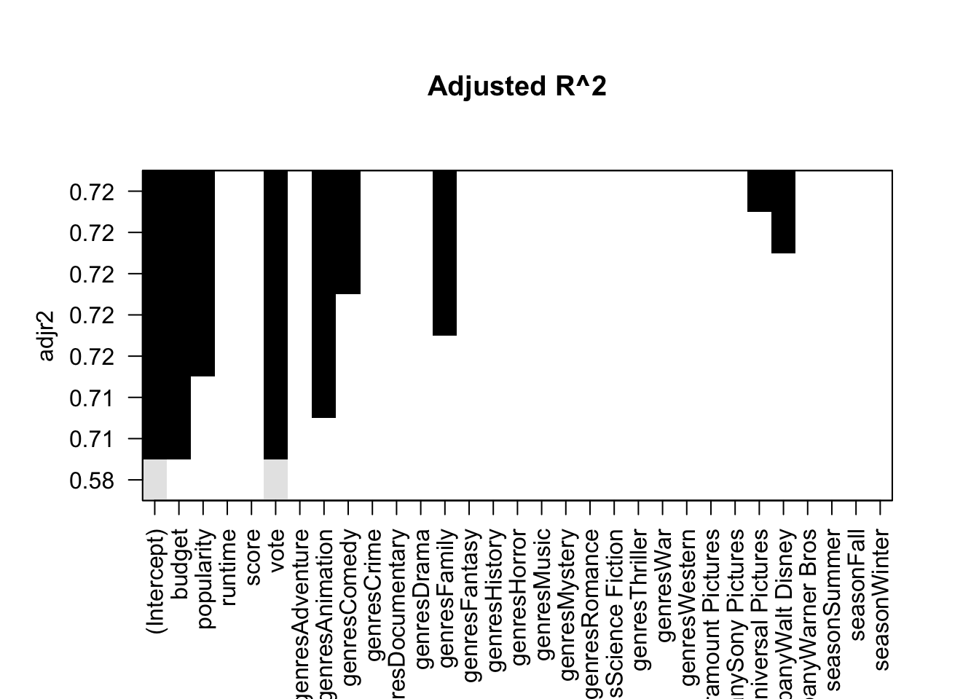
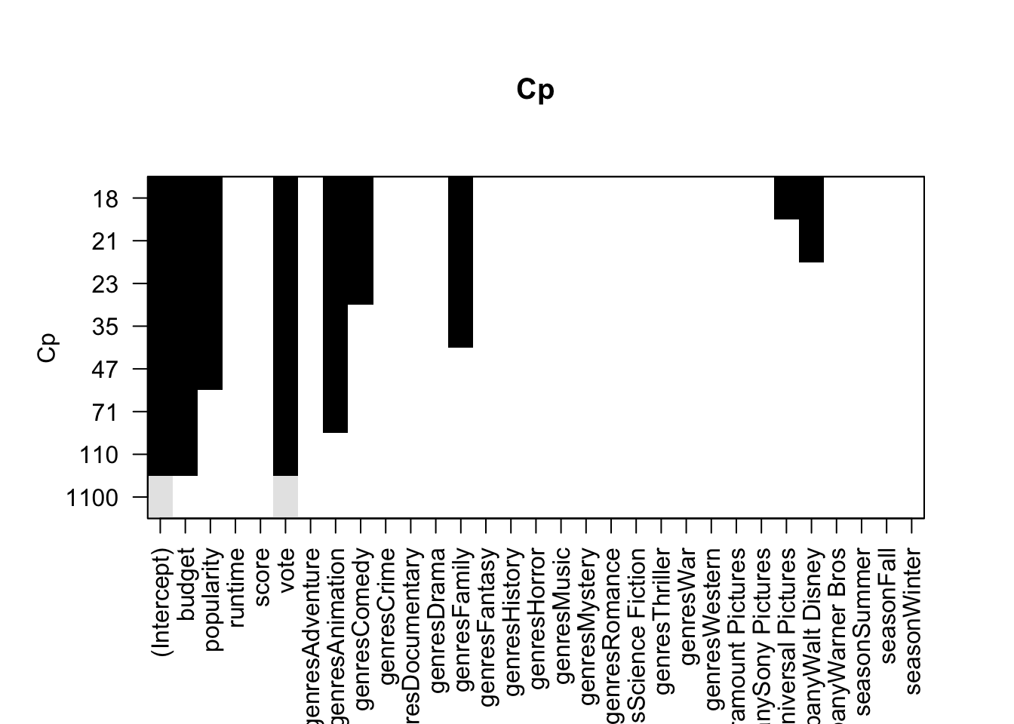
Feature Selection

Slide 11
Linear Regression
revenue ~ vote + popularity + budget + company + genres
R-squared | Adj R-squared | F-statistic | p-value
0.725 | 0.721 | 255 | <2e-16
The results are the same as the model with full predictors.
All coefficients of numerical variables are statistically significant.

Slide 12
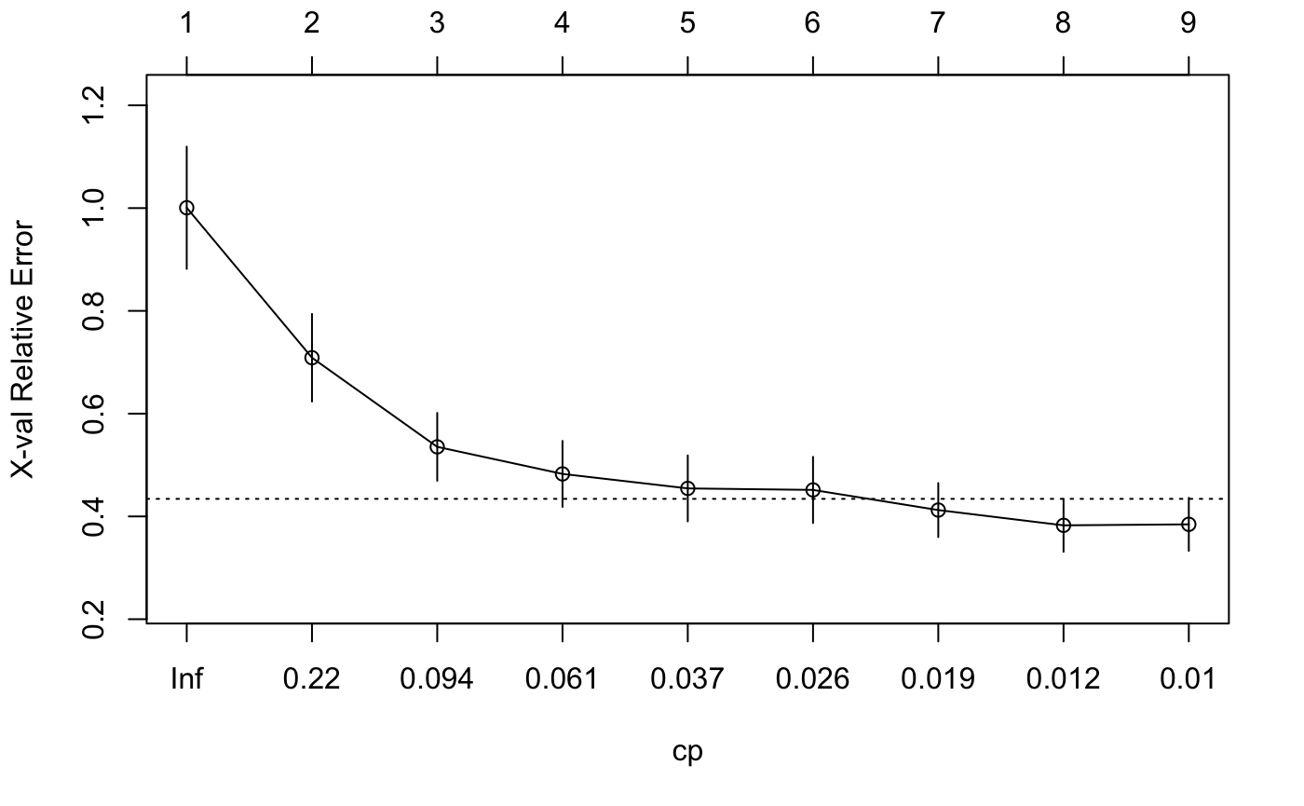
Regression Tree
CP | Rel Error
1 | 1.000
2 | 0.709
3 | 0.535
4 | 0.483
5 | 0.455
6 | 0.452
7 | 0.412
8 | 0.383 (min)
9 | 0.385

Slide 13
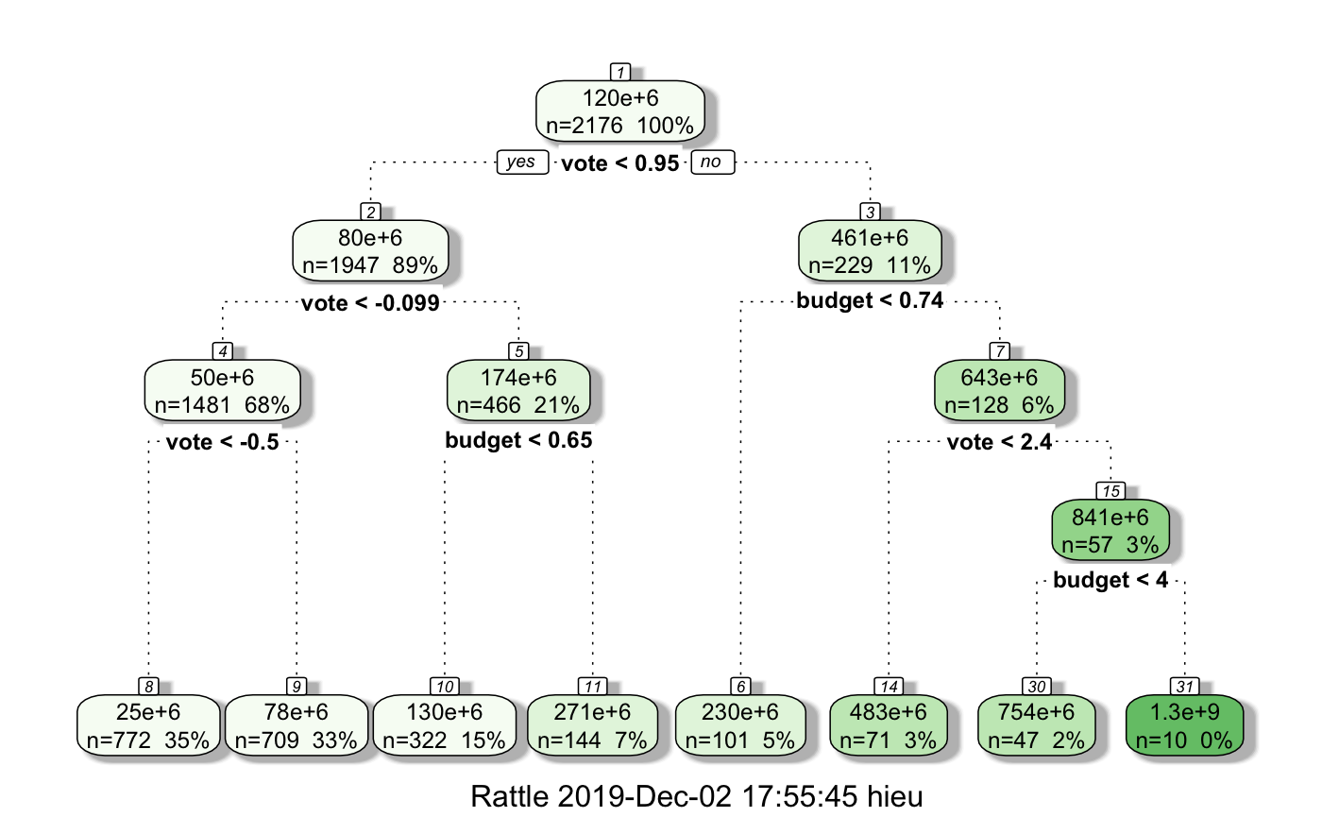
Pruned Tree

Slide 14
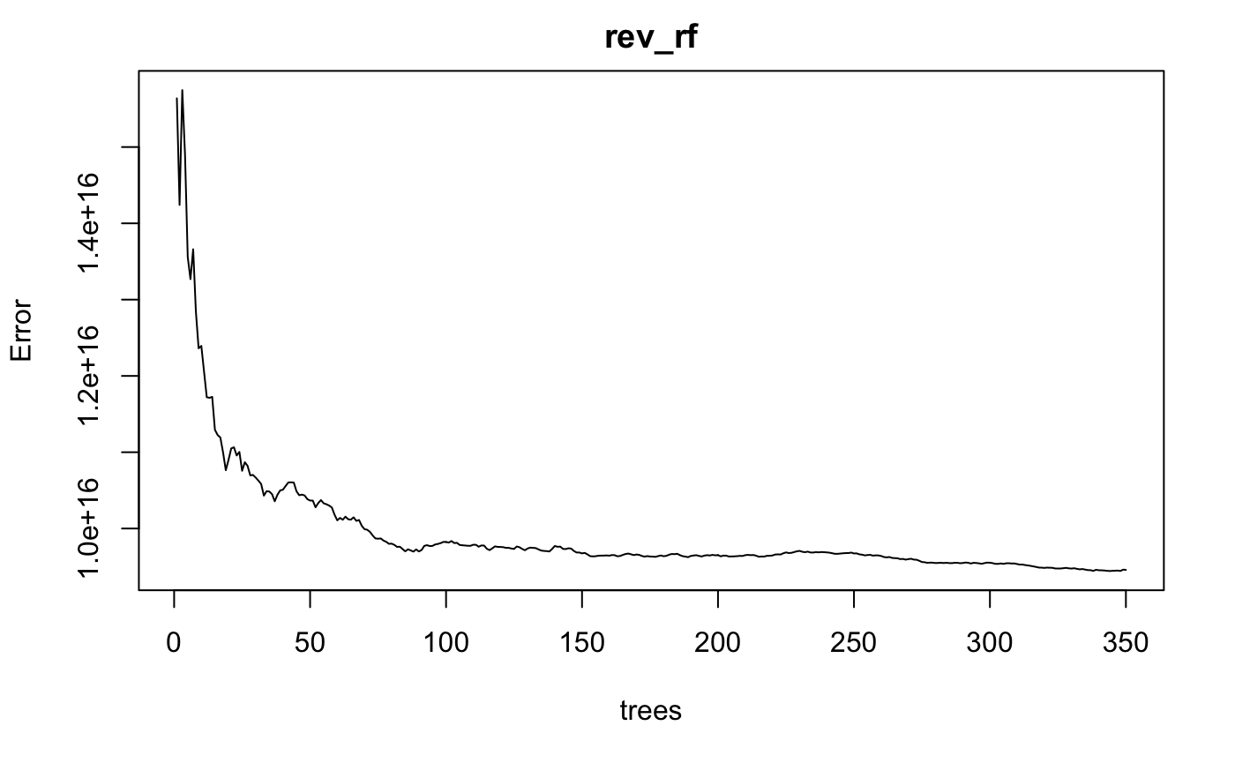
Random Forest

Slide 15
Random Forest
Formula: revenue ~. , ntree = 350, data = training
Pseudo R-squared | OOB Error[350] | mtry
0.732 | 9.46e+15 | 2
Variable | Importance
budget | 1.90e+19
popularity | 1.43e+19
runtime | 4.15e+18
score | 3.39e+18
vote | 2.33e+19
genres | 5.58e+18
company | 2.60e+18
Season | 1.49e+18
Number of variables at a split is 2.
The R-squared in RF is higher than in LM.

Slide 16
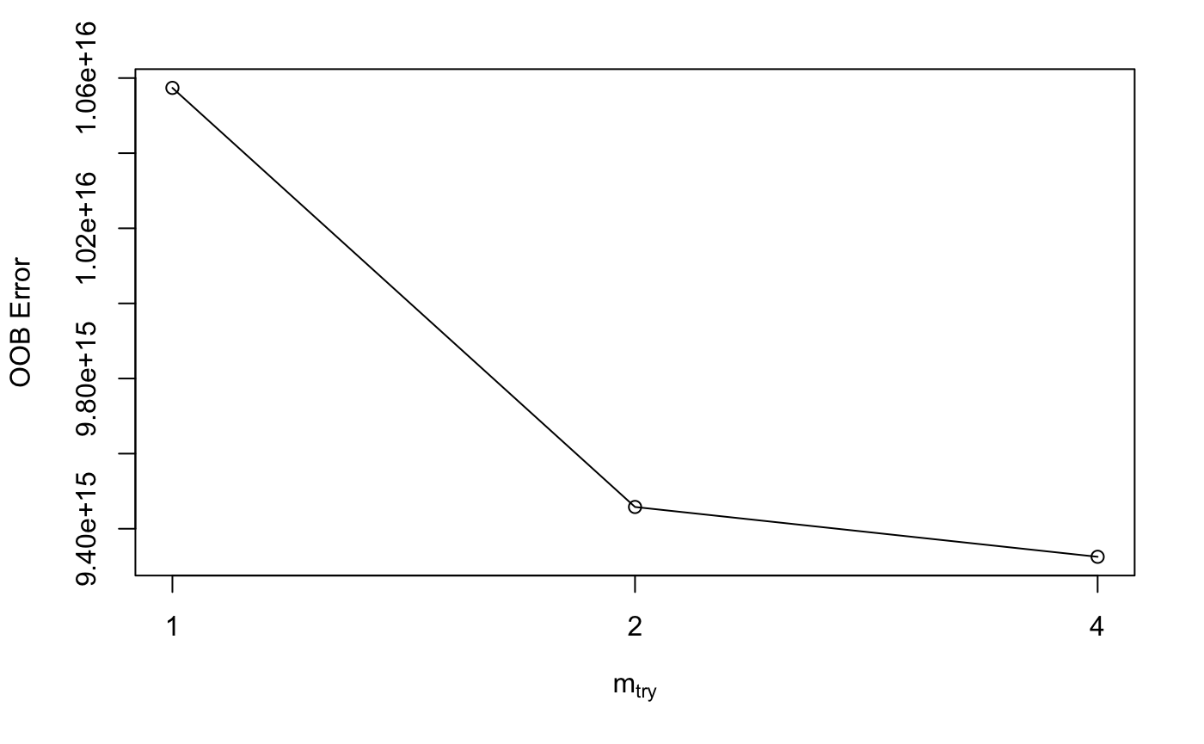
Hyperparameter Tuning

Slide 17
Tuned Random Forest
revenue ~. , ntree = 350, mtry = 4
Pseudo R-squared | OOB Error[350]
0.740 | 9.17e+15
Pseudo R-squared improves from 0.732 to 0.740.
Lower OOB Error[350] / MSE.
After tuning, we receive better results.

Slide 18
Model Comparison
Metrics |  | Linear Model | Regression Tree | Random Forest
R-squared |  | 0.721 | 0.711 | 0.741
MAE | Train | 5.8e+07 | 6.0e+07 | 5.2e+07
 | Test | 6.2e+07 (+6.9%) | 6.6e+07 (+10%) | 5.5e+07 (+5.7%)
RMSE | Train | 9.9e+07 | 1.0e+08 | 9.6e+07
 | Test | 1.0e+08 (+1%) | 1.1e+08 (+10%) | 9.7e+07 (+1%)
Random Forest has the best performance.

Slide 19
Profit Prediction

Slide 20
Profit
Profit Analysis
Briefly examine the correlations between profit and the other variables
Build a Linear Regression model by feature selection
Attempt to train the data with Ridge Regression and Lasso Regression to see if it might be overfit
Build random forest regression
Try to predict the profit of some movies in the future

Slide 21
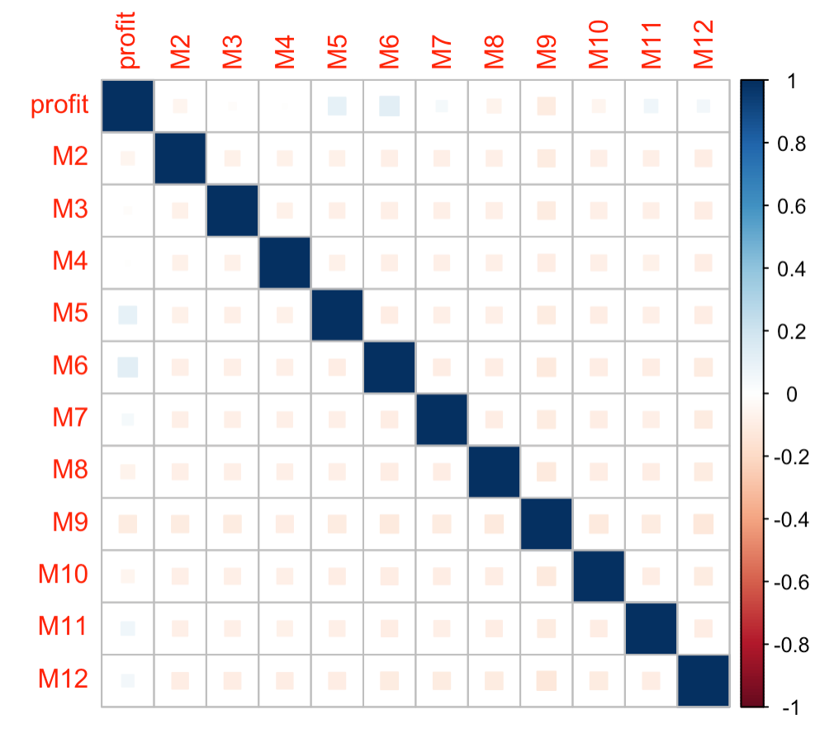
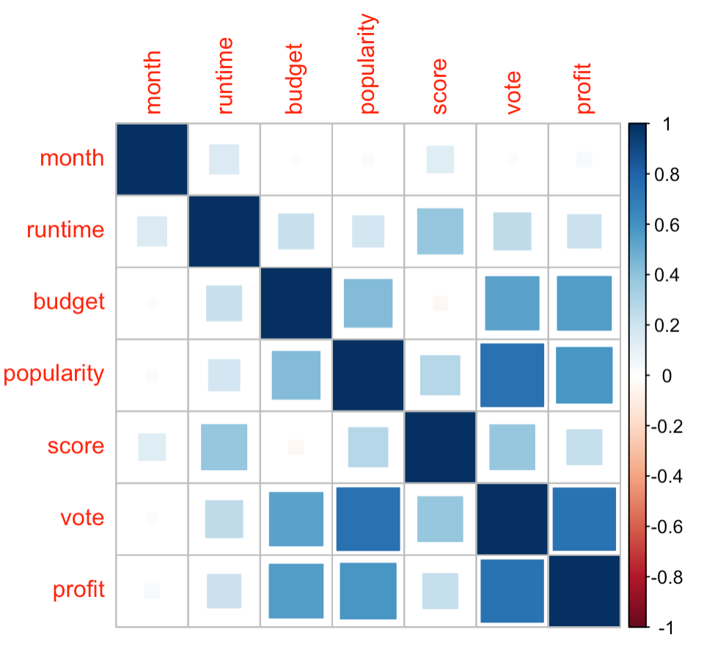
Profit
Correlation Matrix
Profit vs. numerical variables
Profit vs. Month

Slide 22
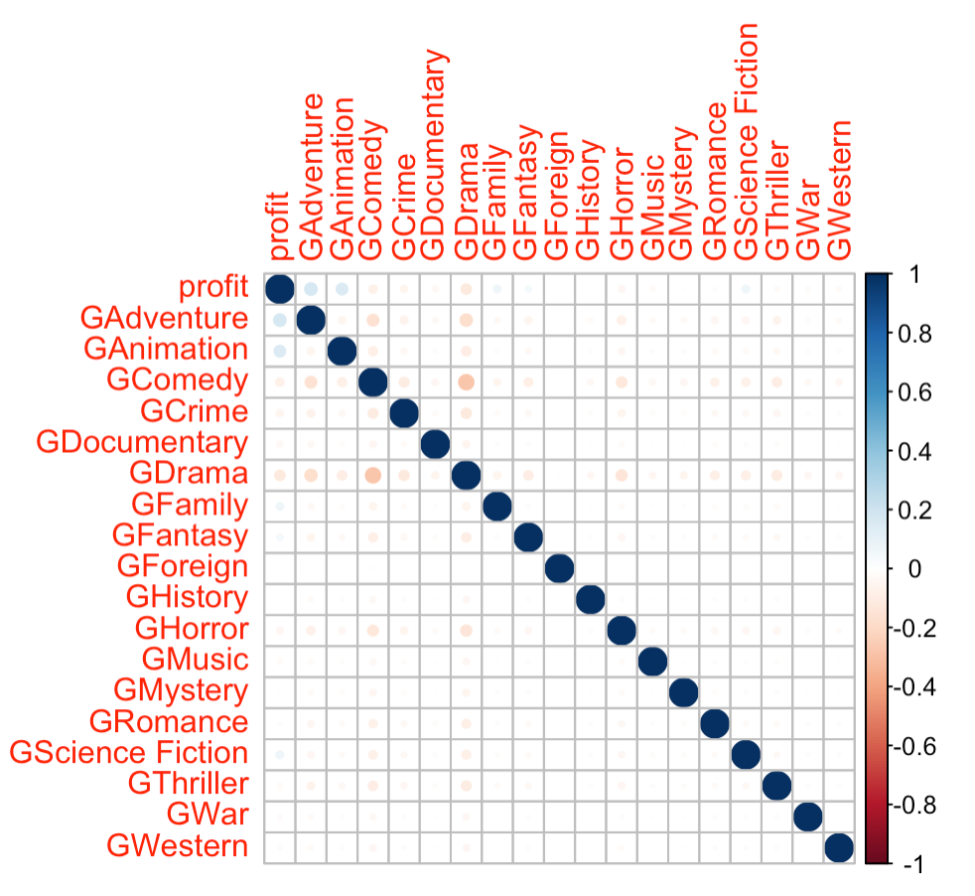
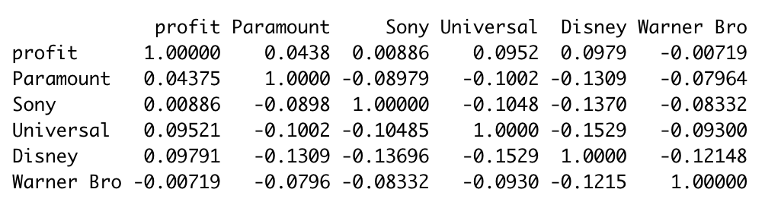
Profit
Correlation Matrix Cont’d
Company does not have strong correlation with profit overall.
Different companies have significantly different impacts on profit
Profit vs. Genre

Slide 23
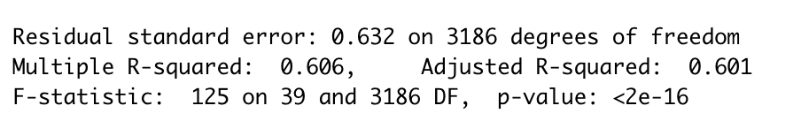
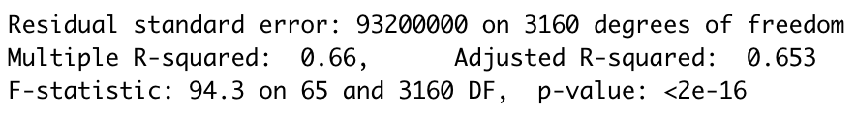
Profit
Linear Regression
Pick relevant and useful variables.
Then take all the variables into account.
The r-squared is 0.601
The model can be improved by adding some polynomials
The amount of predictors becomes increasingly large

Slide 24
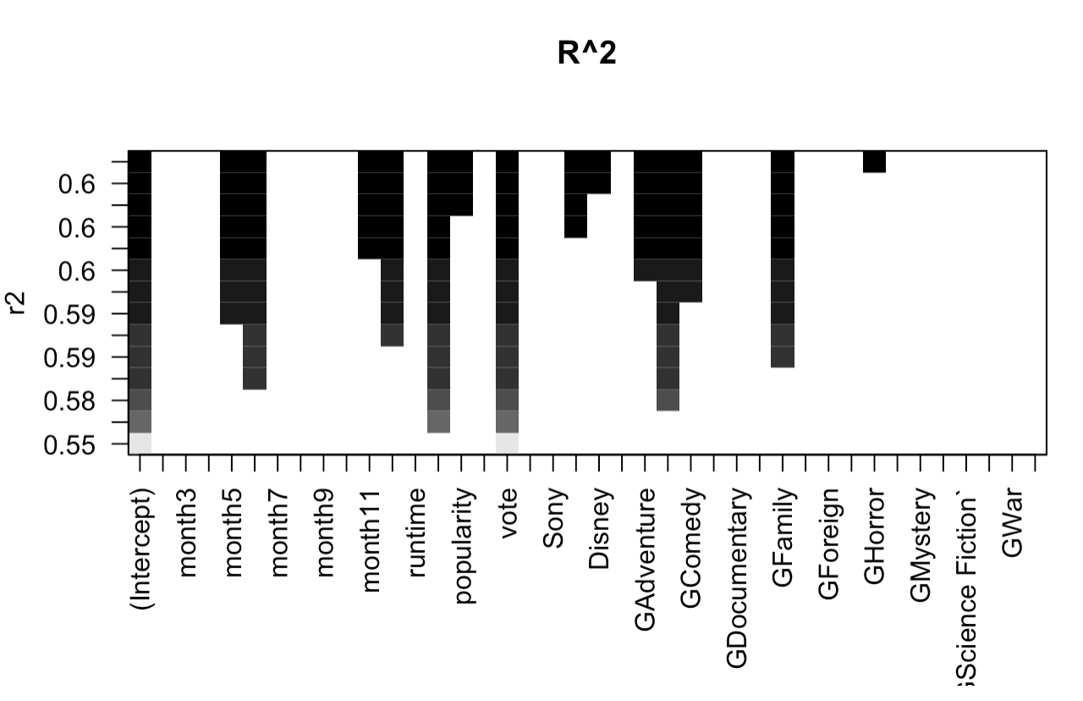


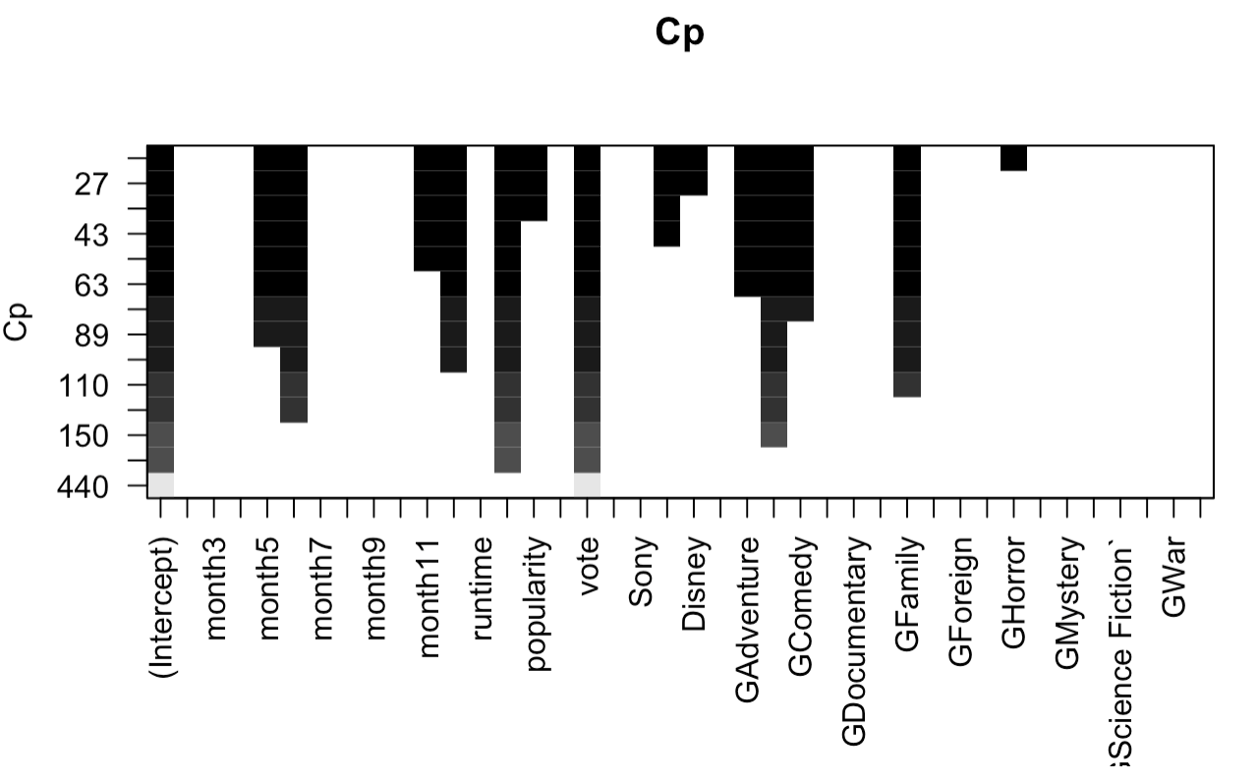
Profit
Feature Selection

Slide 25
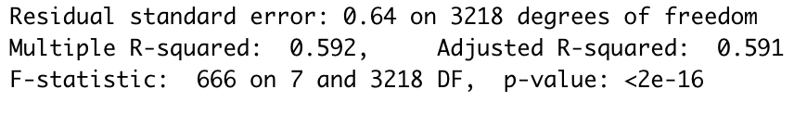
Profit
Linear Regression w/ Feature Selection
Originally, we have 39 features as predictors, and the r-square is 0.601. To achieve a higher r-square of 0.653, we may have around 60 features
With feature selection, we reduce the amount of predictors to 7: (budget, vote, May, June, December, genre Animation, and genre family)
The new r-square value is 0.591, pretty close to 0.601

Slide 26
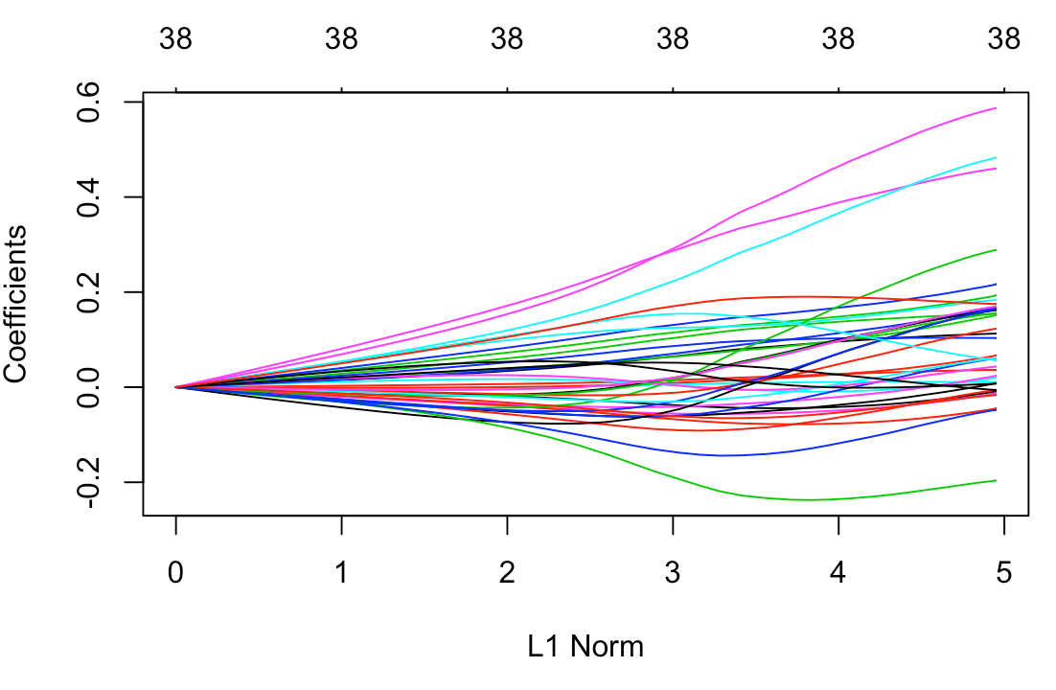
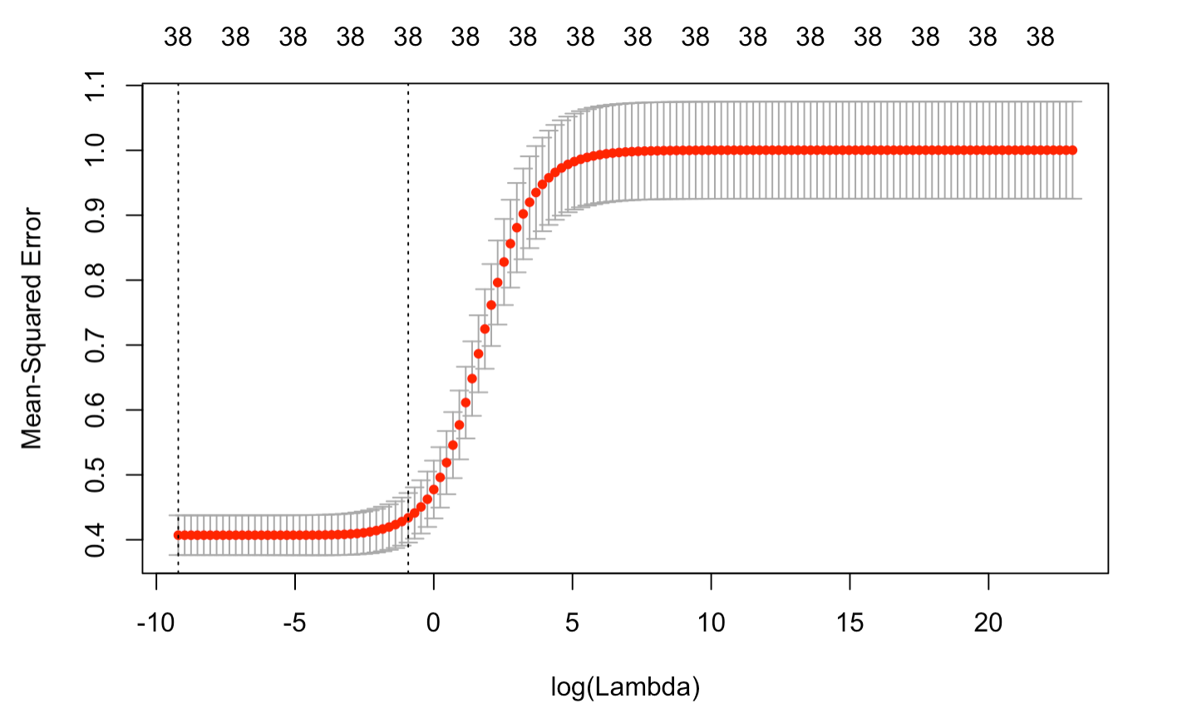
Profit
Ridge Regression
Ridge Regression
best lambda: 0.0398
the new r-square: 0.604

Slide 27
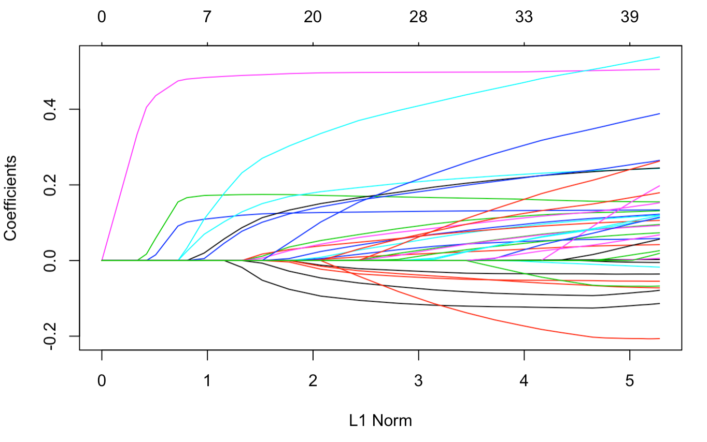
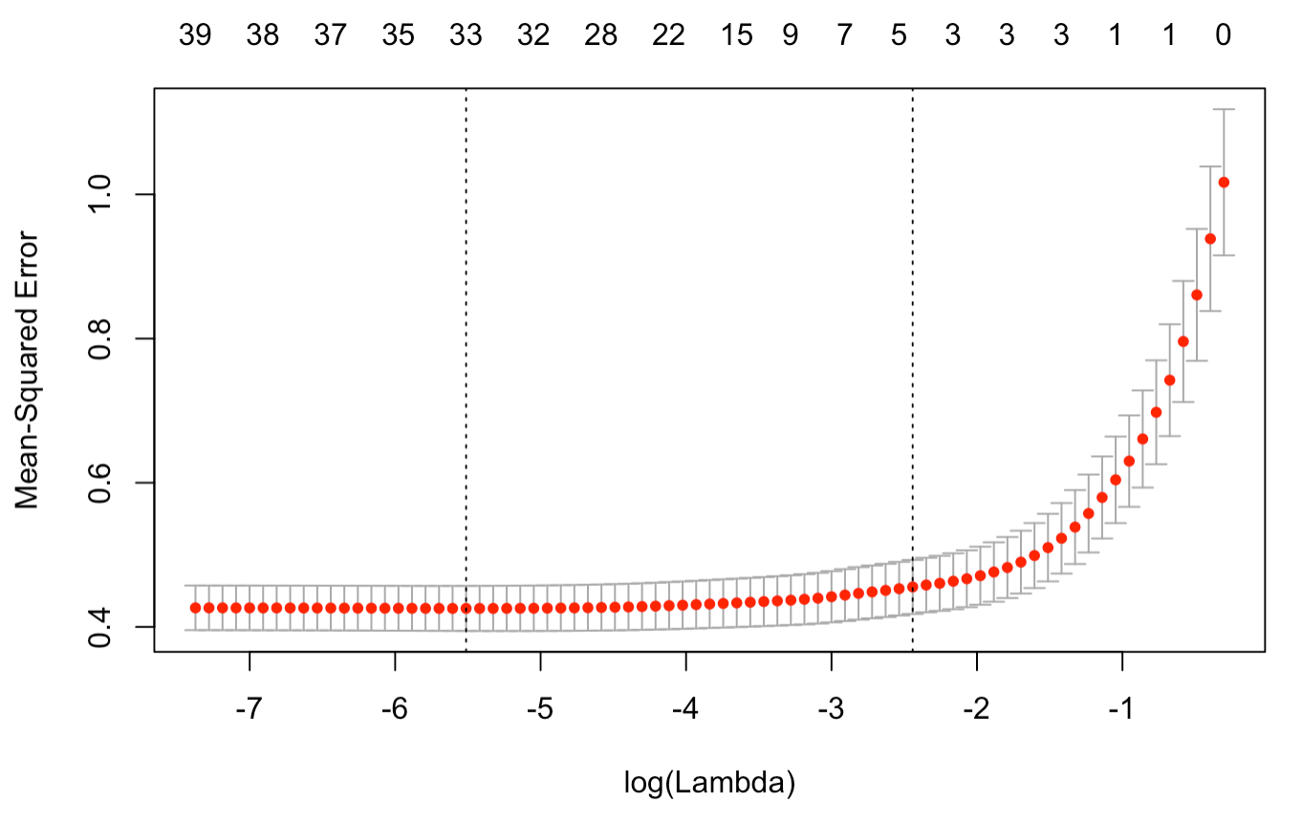
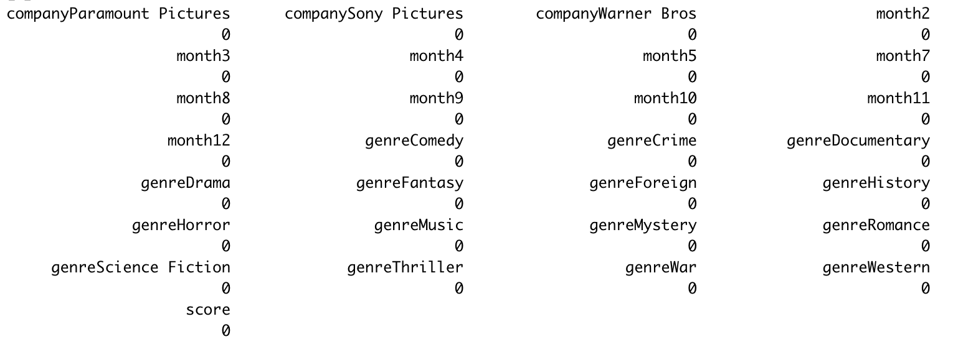
Profit
Lasso Regression
Lasso Regression
best lambda: 0.00501
the new r-square: 0.604
29 of the coefficients become zero
Notes:
By Wald test:
Different genres do not have significant effects on the response in our logit model.
Different companies are significant.
The effects of different seasons are significant, but not as clear as the effects of different companies.

Slide 28
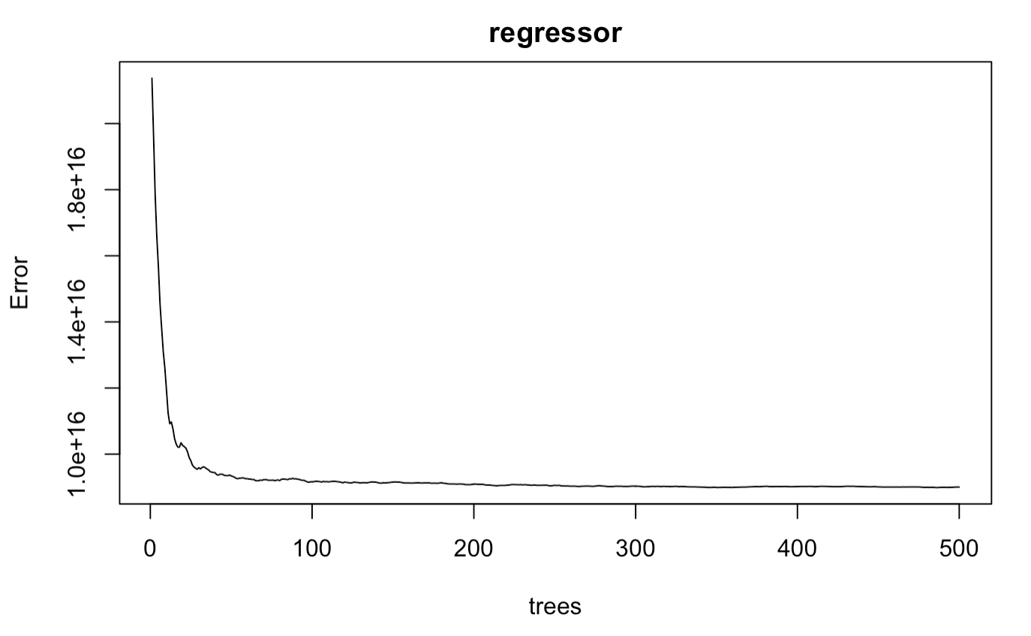
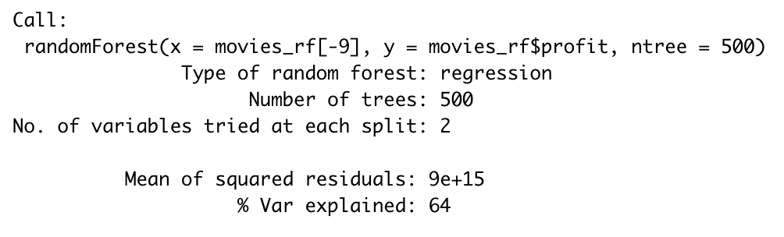
Profit
Random Forest Regression

Slide 29
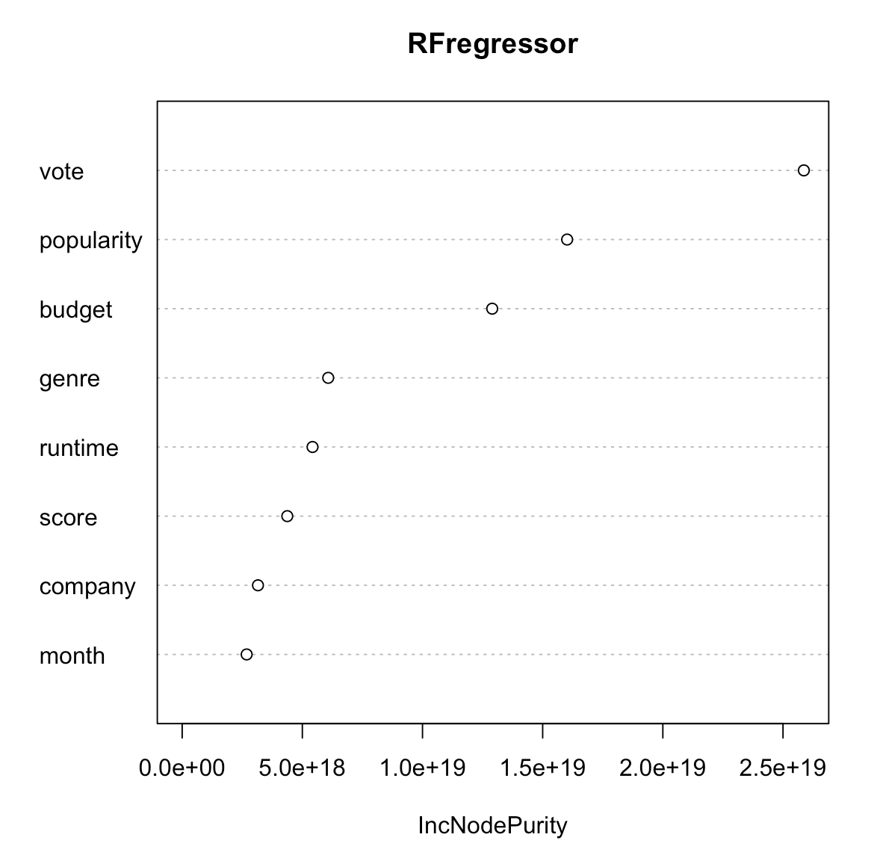
Profit
Random Forest Regression
Variable Importance
From high to low:
Vote
popularity
budget
genre
runtime
score
company
month

Slide 30

Profit
Actual Predictions
Frozen II (2019)
Release in Nov.
Carries a $33 million budget
Animation
Runtime 1h44min
etc.
The predict profit would be:
$521,197,933 -with RF
$590,351,271 -with LM

Slide 31
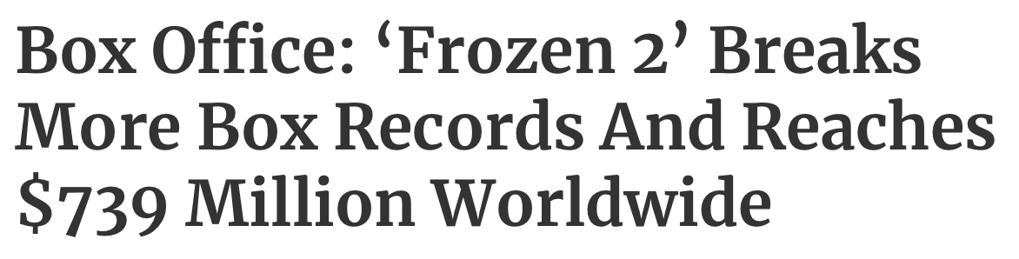
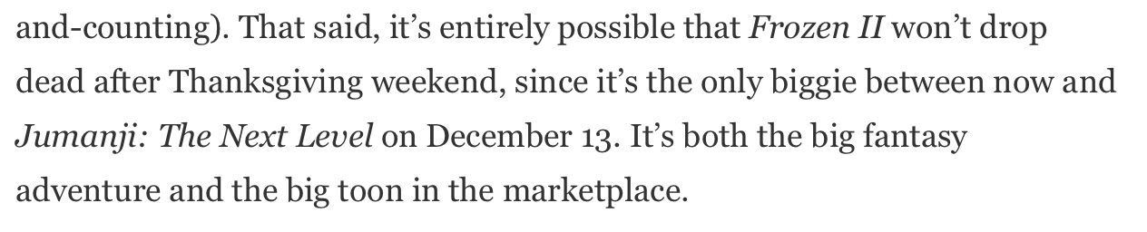
Profit
Extension
However, ‘Frozen II’ already earns a lot more than we expect
Factors that affect profit are complicated and diverse. Like brand influence and the rivals.

Slide 32
Principal Component Analysis

Slide 33
Principal Component Analysis
Purposes
Dimensional reduction.
Data storage optimization.
Computational speed optimization.
Expectation
Not losing much predictive power.
Remove multicollinearity between predictors
Model
revenue ~ budget + score + vote + popularity + runtime

Slide 34
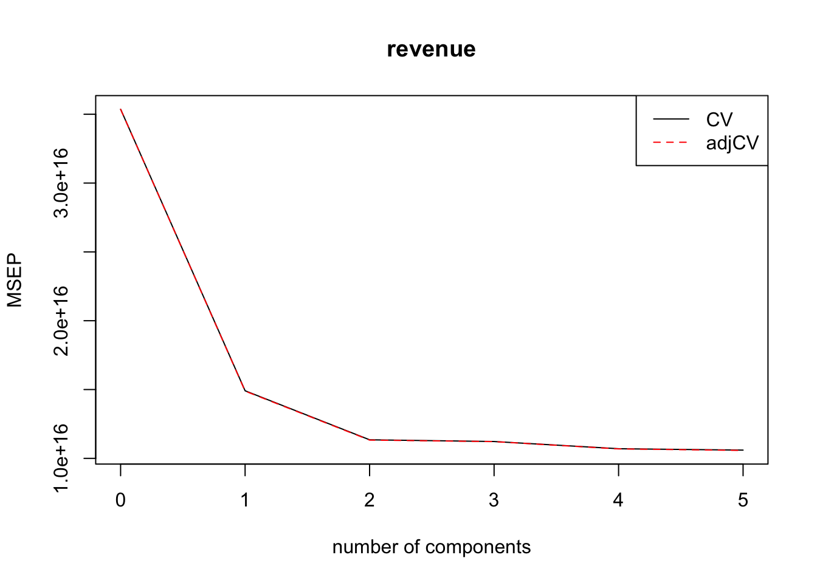
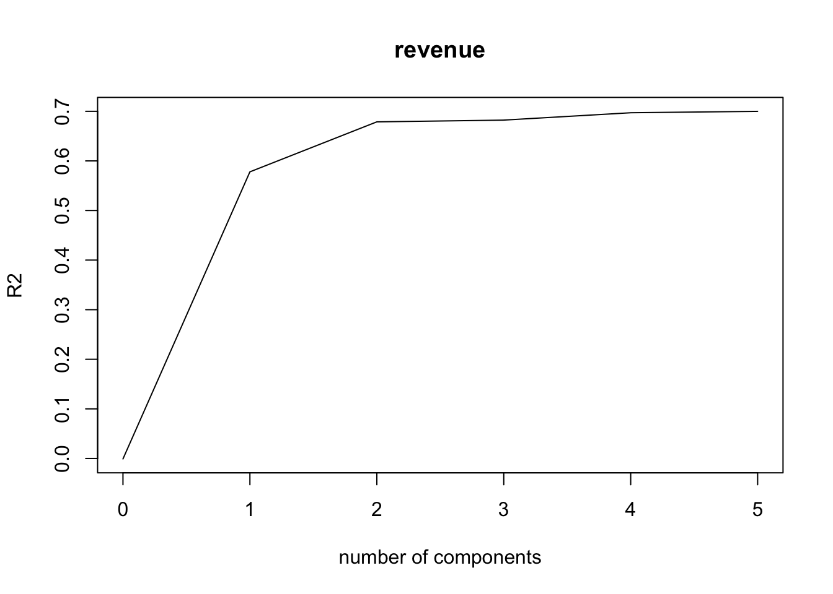
Principal Component Analysis
2 components are enough to capture 95% of the MSEP and R-squared.

Slide 35
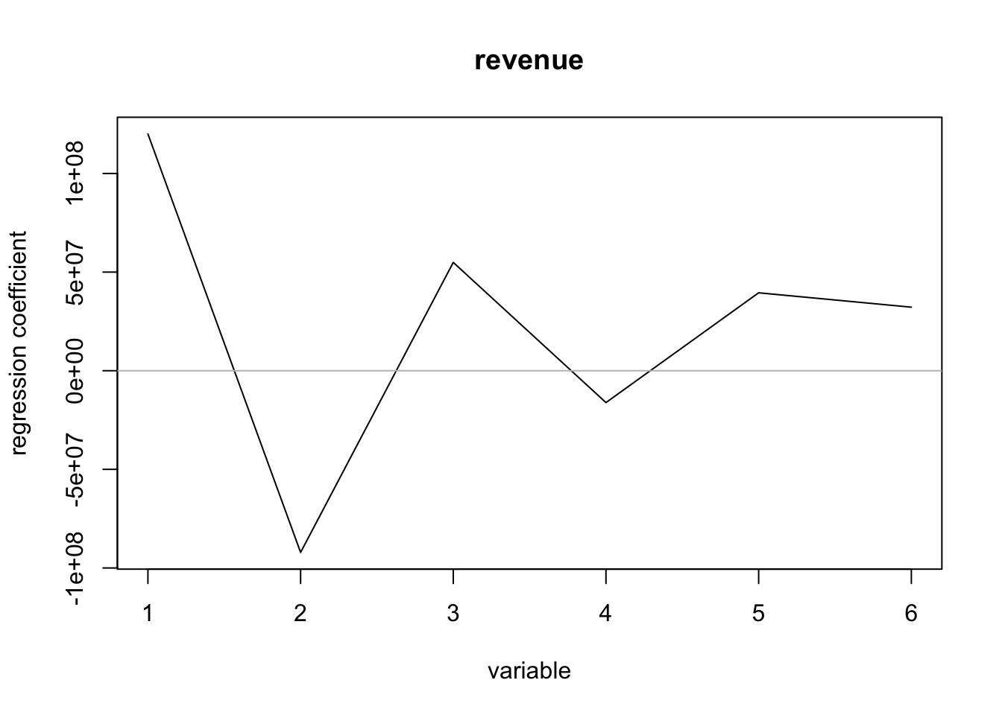
Principal Component Coefficients
After the second components, the differences of coefficients are not drastic.

Slide 36
Principal Component Regression
Training | % var explained
X | 48.50 | 71.69 | 87.41 | 95.61 | 100.00
revenue | 58.21 | 68.09 | 68.67 | 70.49 | 71.13
To capture 80% of the variance of predictors, we need 3 components.
To explain the response revenue, 2 components are enough.

Slide 37
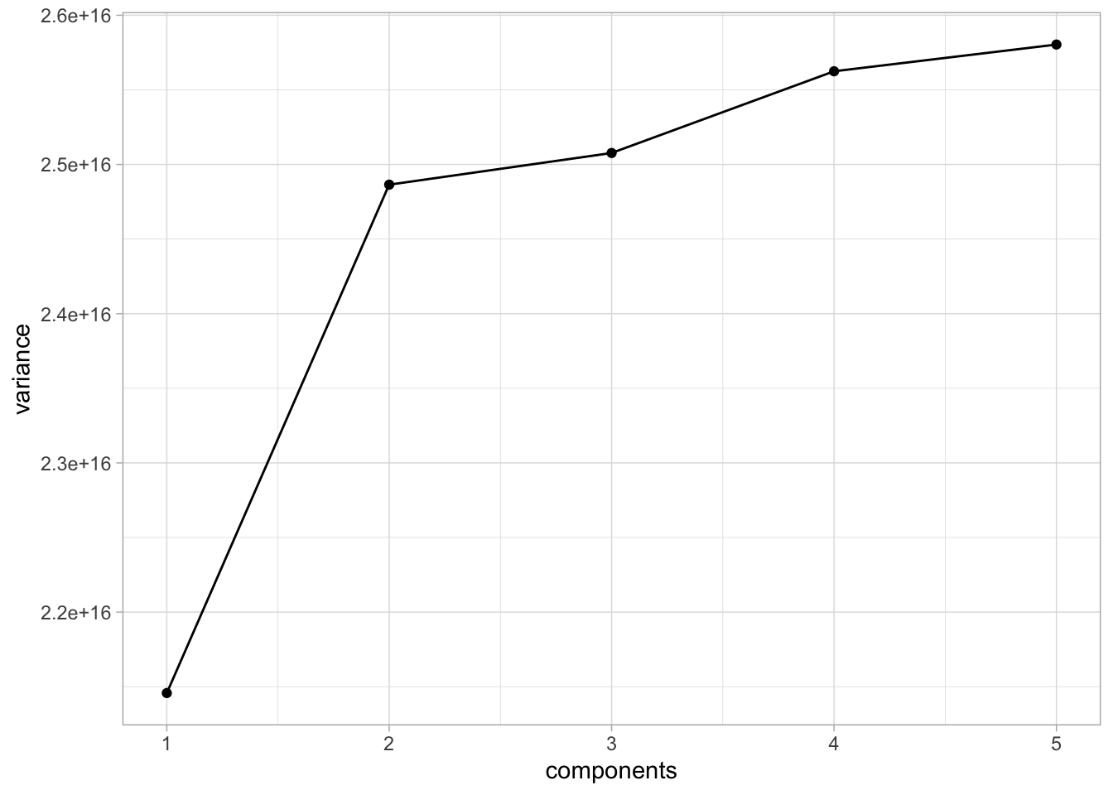
PCR Validation on Testing Data
With 2 components, we still capture 95% of the variance.
Our PCR seems to perform properly on the testing data.

Slide 38
Linear Model with PCs
Metrics | 5 Original Variables | 2 Principal Components
Adj R-squared | 0.711 | 0.681
RMSE - train | 1.01e+08 | 1.06e+08
RMSE - test | 1.06e+08 | 1.55e+08 (+46%)
The R-squared does not reduce a lot when we using PCA.
The predictive power seems to be influenced as RMSE in testing set increases by 46%.
Potential overfitting when using PCs to build linear model.

Slide 39
Profitability Prediction

Slide 40
Model Overview
Response: y – binary output (0,1).
0 – the movie does not gain profit (revenue < budget).
1 – the movie gains profit (revenue > budget).
Predictors:
Numerical variables: budget, runtime, vote, popularity, score.
Categorical variables: company, season, genres.

Slide 41
Logistic Regression
Formula: y ~ . , data = training data
Null deviance | Residual deviance | AIC
2409.2 | 1805.0 | 1867
We observe that some predictors are not statistically significant.

Slide 42
Wald Test
Variables | Company | Season | Genres
p-value | 8.4e-09 | 0.045 | 0.12
The overall effect of company is clearly statistically significant.
The overall effect of season is not statistically significant.
Genres can be removed from the model formula.

Slide 43
Model Selection - AIC
budget | popularity | runtime | score | vote | genres | company | season | criterion
true | false | false | true | true | false | true | true | 1855
true | true | false | true | true | false | true | true | 1856
true | false | true | true | true | false | true | true | 1857
true | true | true | true | true | false | true | true | 1858
true | false | false | true | true | false | true | false | 1858
Best logit model formula: y ~ budget + score + vote + company + season

Slide 44
Predicted Probability & Accuracy
Predicted Probability Cut-off | Accuracy | Kappa
0.5 | 81.9% | 0.425 (moderate)
0.6 | 80.7% | 0.486 (moderate)
0.7 | 77.4% | 0.476 (moderate)
0.8 | 69.0% | 0.379 (fair)
0.9 | 59.2% | 0.280 (fair)
Predicted Probability > cut-off, y = 1; otherwise y = 0.
The results show that the cut-off 0.5 gives the best prediction on testing set, while the cut-off 0.6 gives the highest interrater reliability.

Slide 45
Exponentiated Coefficients
Variables | exp(coef)
budget | 0.99999999817 (~ 1)
score | 1.234
vote | 1.003
Paramount Pictures | 2.623
Universal Pictures | 2.322
Sony Pictures | 1.729
Walt Disney | 2.399
Warner Bros | 2.200
Summer | 1.469
Fall | 0.993
Winter | 1.055

Slide 46
Model Evaluation
Hosmer and Lemeshow goodness of fit:
Since p-value <2e-16, our logit model seems to be a good fit.
McFadden:
23.9% variations in y is explained by explanatory predictors in the model.

Slide 47
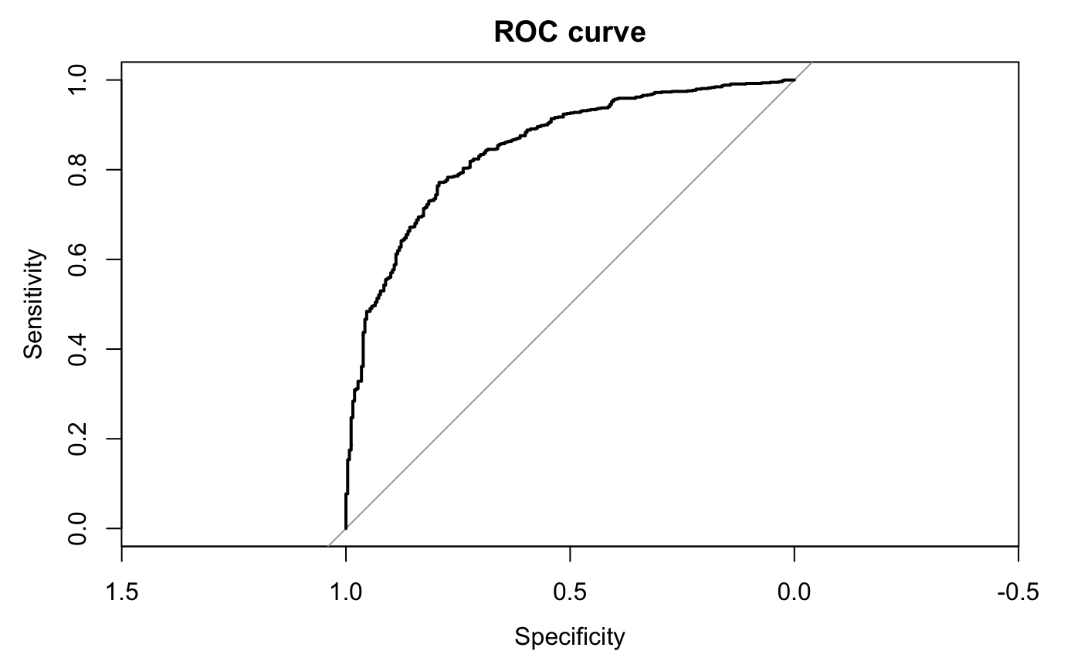
ROC Curve and AUC
AUC = 0.849

Slide 48
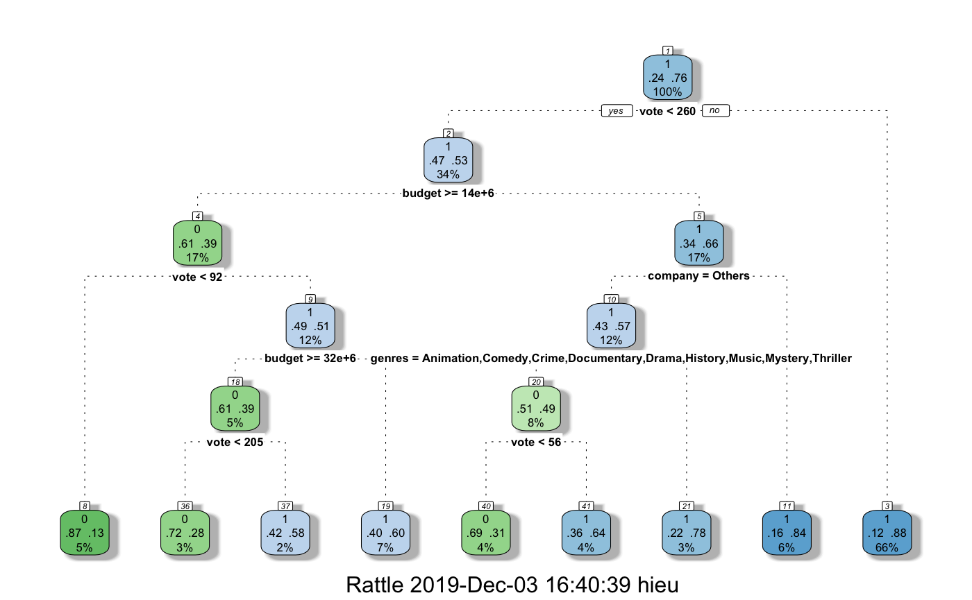
Classification Tree

Slide 49
Confusion Matrix - Decision Tree
actual prediction | 0 | 1
0 | 88 (True Negative) | 35 (False Positive)
1 | 172 (False Negative) | 754 (True Positive)
accuracy = 80.3%
kappa = 0.357 (fair)

Slide 50
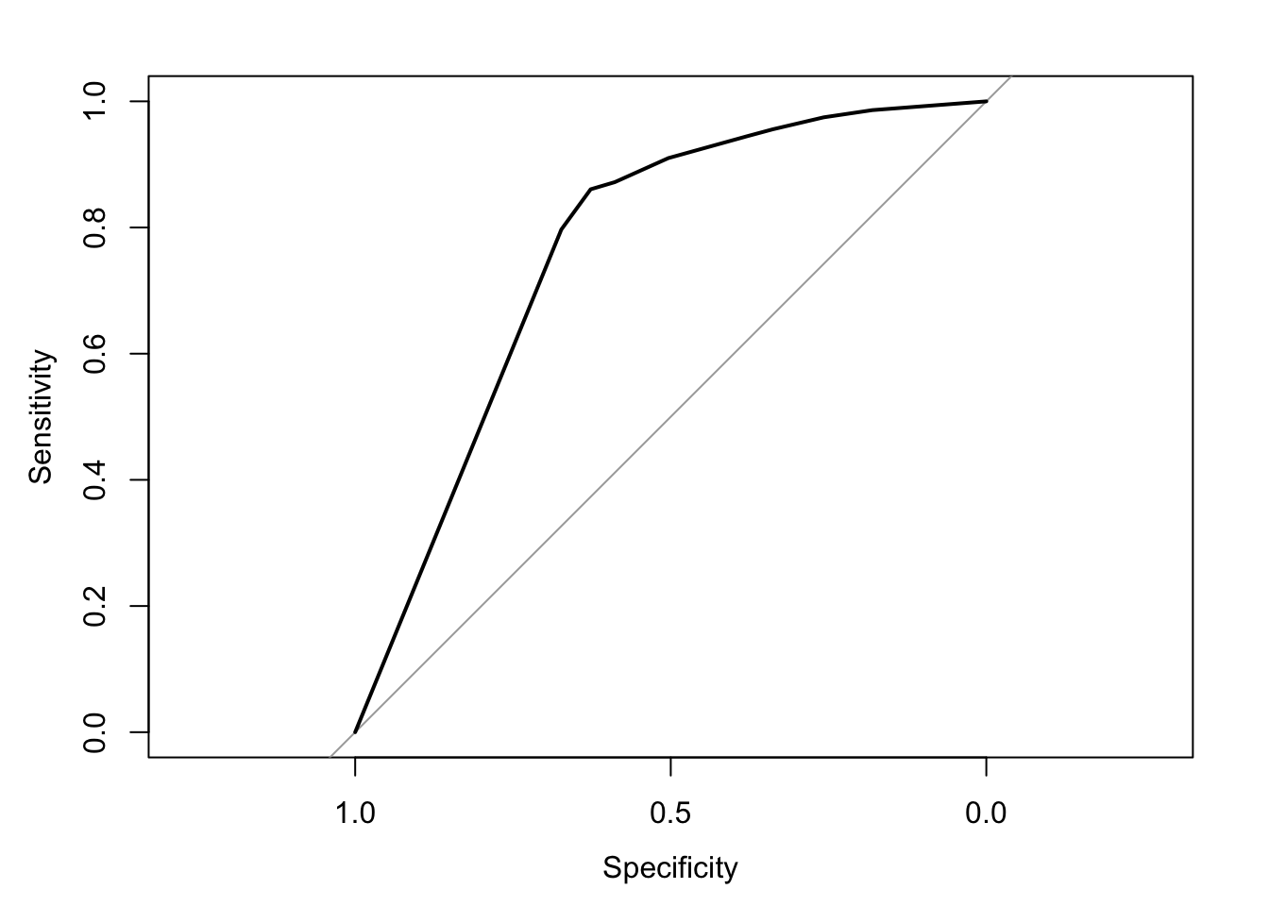
ROC Curve and AUC
AUC = 0.764
Logit Model is better than Classification Tree in our case.

Slide 51
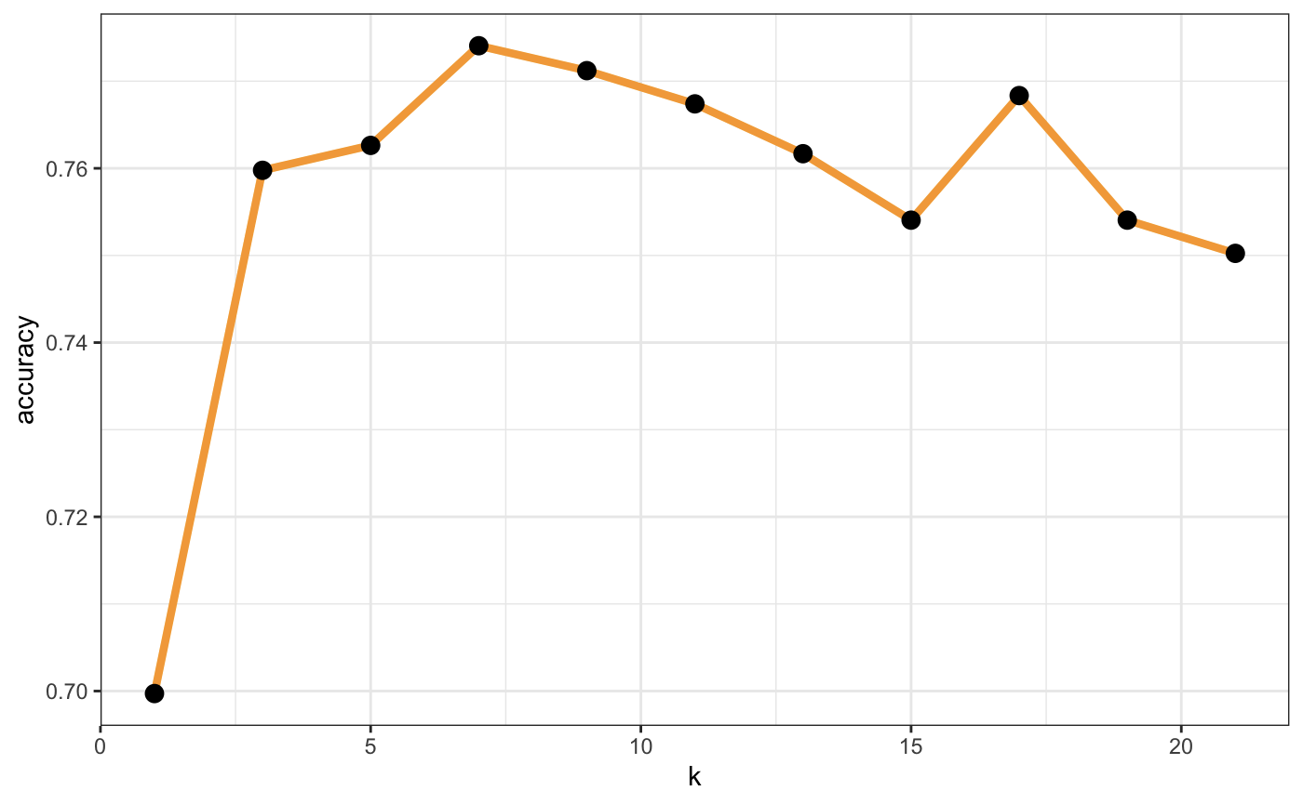
KNN Model
Best accuracy at k = 7.

Slide 52
Confusion Matrix - KNN
actual prediction | 0 | 1
0 | 90 (True Negative) | 67 (False Positive)
1 | 170 (False Negative) | 722 (True Positive)
accuracy = 77.4%
kappa = 0.301

Slide 53
Seasonality Trends

Slide 54
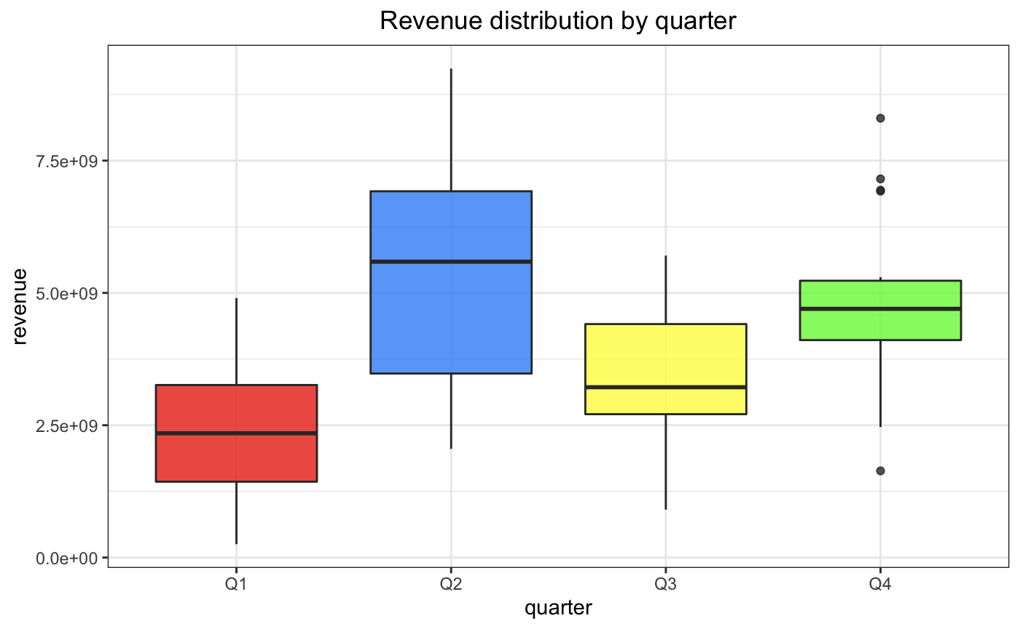
Revenue Distribution by Quarter

Slide 55
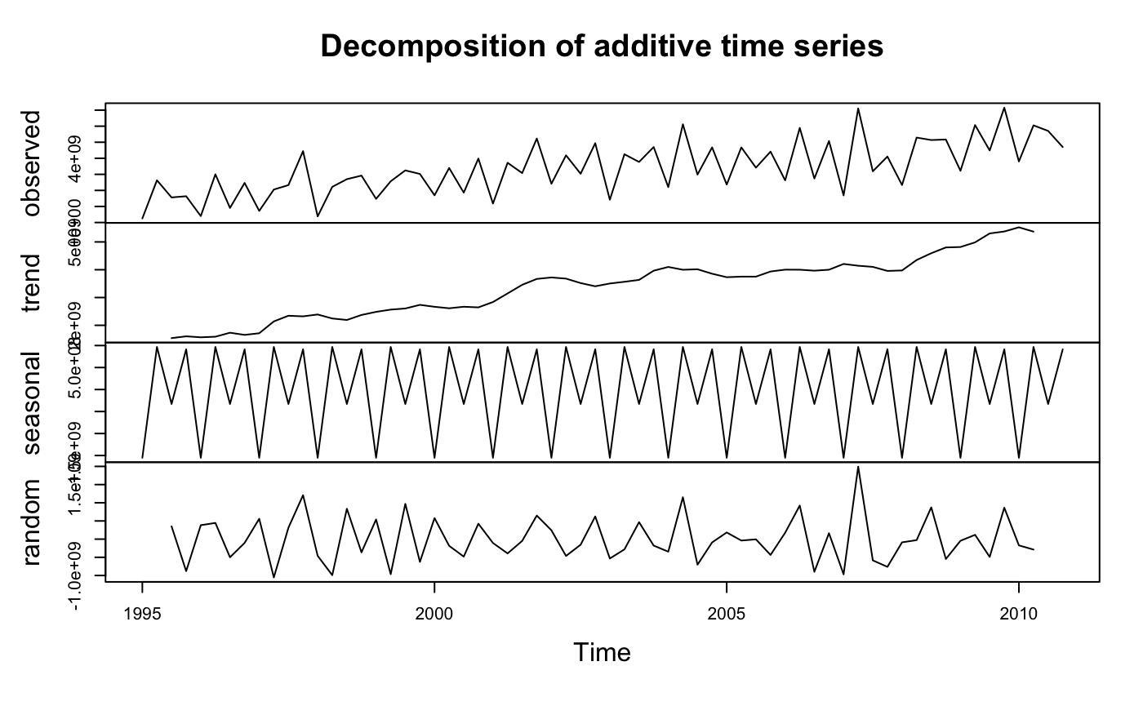
Time Series

Slide 56
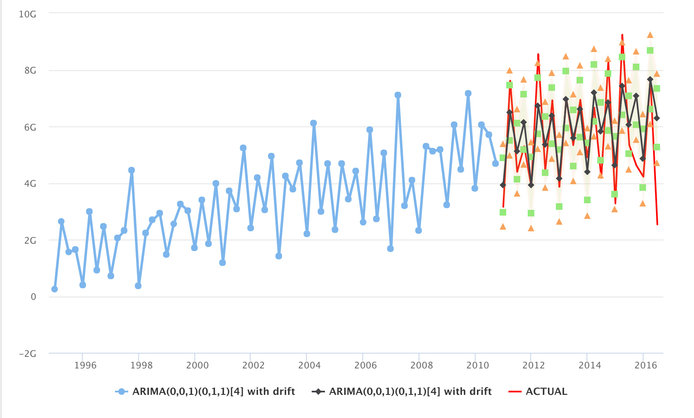
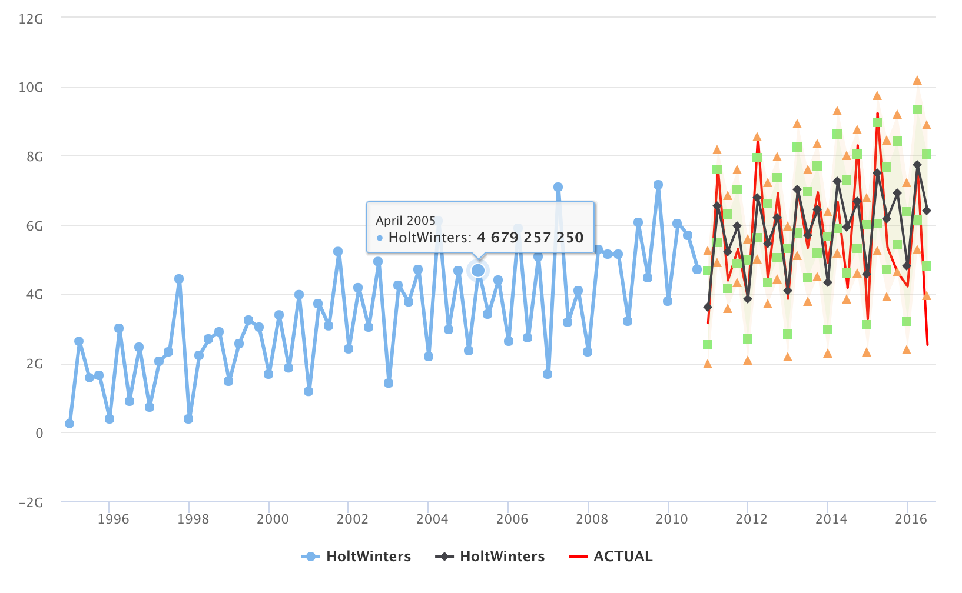
Time Series
ARIMA
HoltWinters

Slide 57
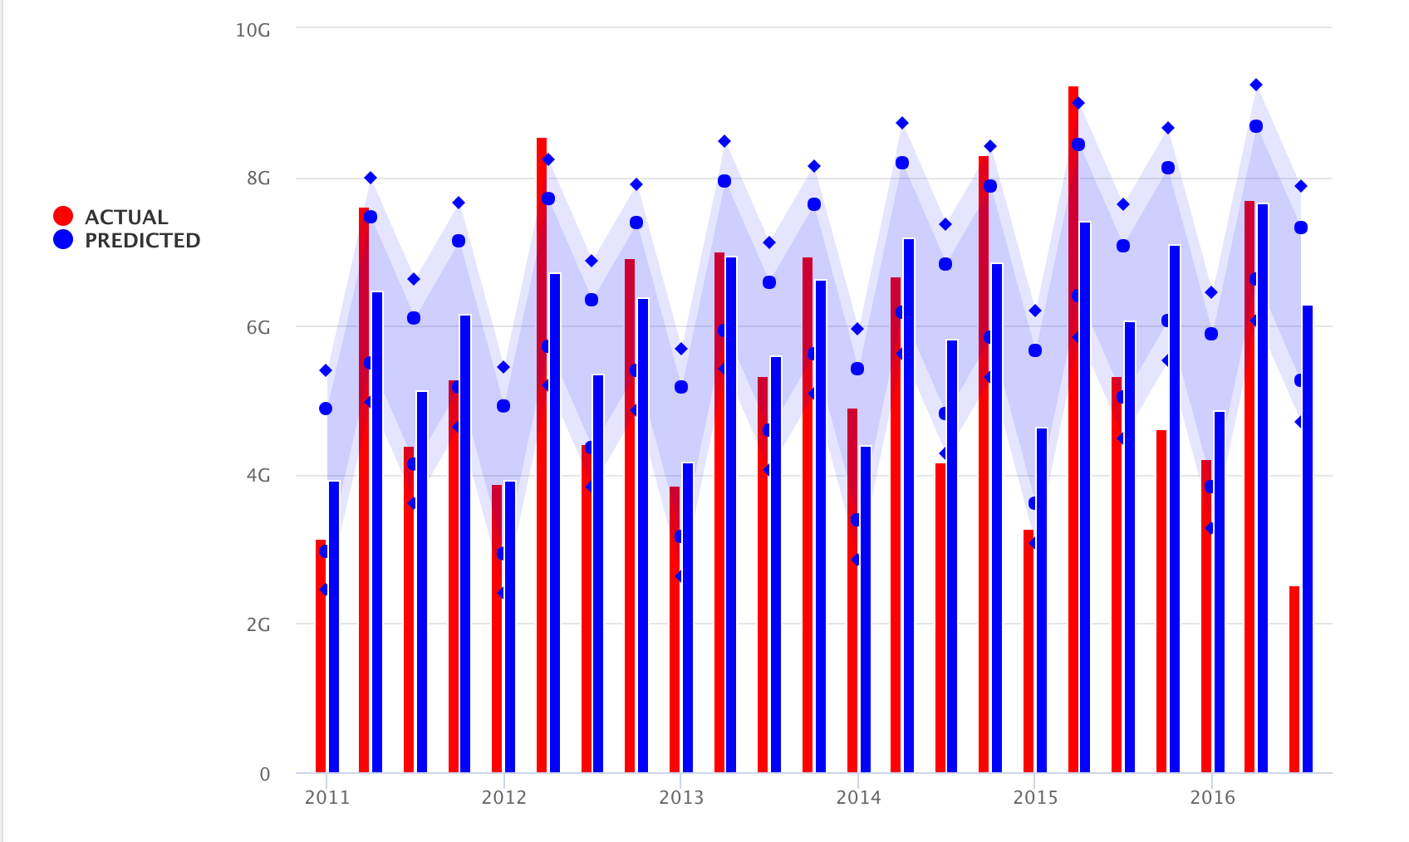
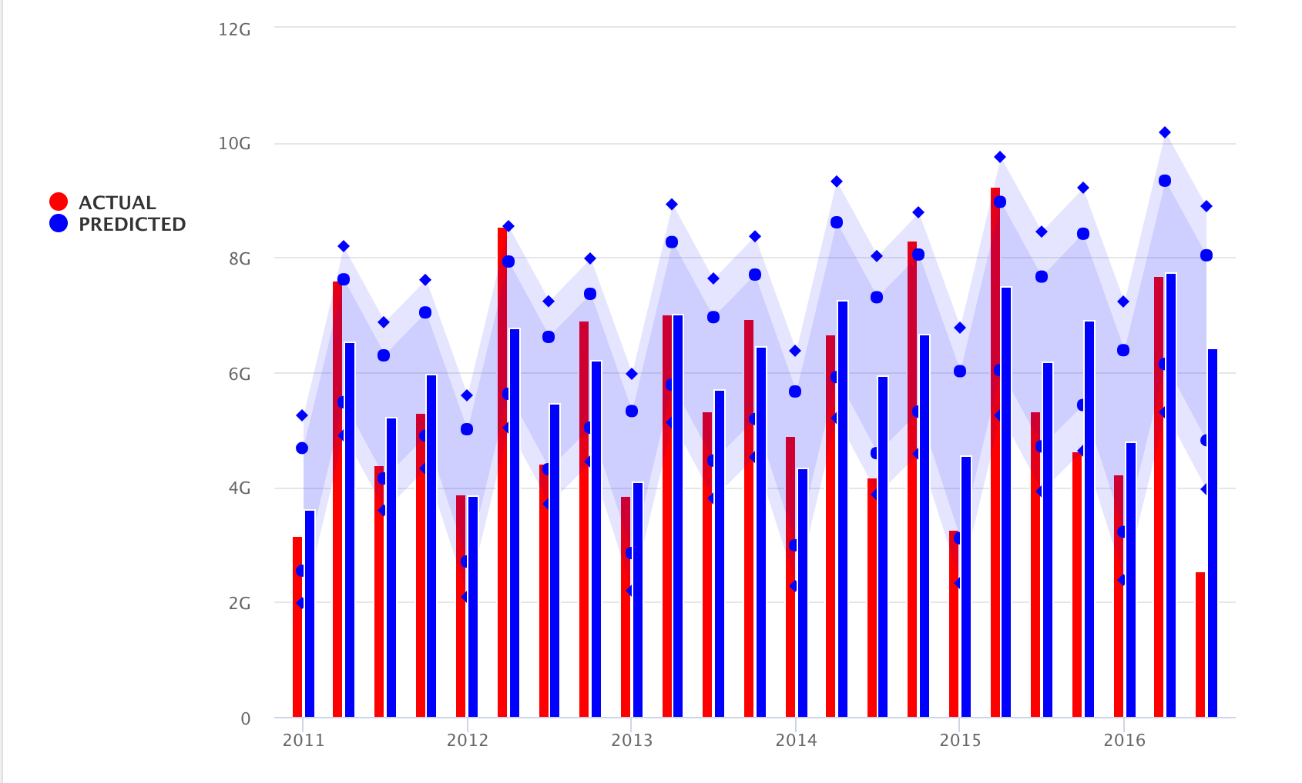
Detailed Visualization
ARIMA
HoltWinters

Slide 58
Model Comparison
Model | RMSE |  | MAE
 | Train | Test | Train | Test
ARIMA | 7.06e+08 | 1.31e+09 | 5.23e+08 | 9.88e+08
HoltWinters | 8.33e+08 | 1.32e+09 | 6.51e+08 | 9.99e+08
ARIMA performs better on the training data.
However, there is no significance between two models when predicting the testing data.

Slide 59
Conclusion
When predicting revenue and profit, Random Forest yields the best performance model.
When predicting profitability, Logistic Regression yields the best performance model.
The most important features that a movie studio/investor should consider for box office success are budget, vote and popularity.
Movies released in April, May and June tend to generate larger revenues.
Movie released in June tend to generate larger profit.

Slide 60
References
https://towardsdatascience.com/
https://stats.idre.ucla.edu/r/dae/
https://stackoverflow.com/
https://www.kaggle.com/learn-forum
https://www.r-bloggers.com/
https://www.datacamp.com/tracks/r-programming
https://www.forbes.com/sites/scottmendelson/2019/12/01/box-office-walt-disney-frozen-2-starring-idina-menzel-and-kristen-bell-breaks-thanksgiving-records-and-tops-738-million-worldwide/#2f2c0c956d80

